Slide 1
InvestMate - The Investment App

Slide 2

InvestMate

Slide 3
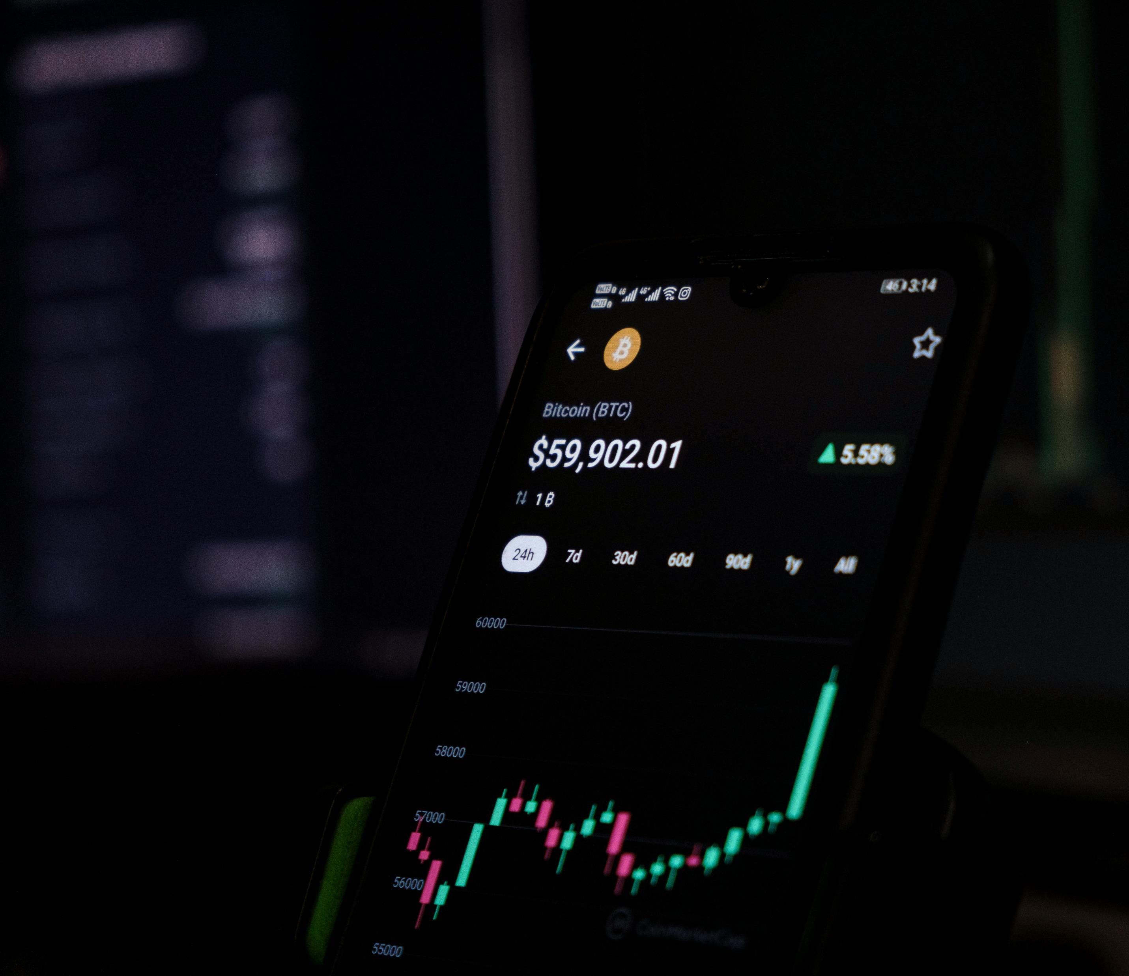
About us
At InvestMate, we understand the challenges and complexities involved in stock market investment and risk management. Our mission is to empower investors—both novice and experienced—by providing the tools, insights, and resources they need to navigate the volatile world of stock markets with confidence and clarity.

Slide 4
PROBLEM sTATEMENT
Investing in the stock market can be a daunting task for both novice and experienced investors. The market is highly volatile, with stock prices influenced by a myriad of factors, including economic indicators, company performance, geopolitical events, and investor sentiment. For example, a retail investor might struggle to keep up with the latest news, analyze complex financial data, and make informed decisions on when to buy or sell stocks. Furthermore, managing risk in a volatile market is challenging, especially when investors lack the tools to diversify their portfolios effectively or protect against sudden downturns. With so much information available, investors often feel overwhelmed and unsure of how to build a strategy that aligns with their financial goals and risk tolerance.

Slide 5

Application benefits
Simplifies the investment process with a user-friendly interface and real-time market data.
Provides personalized investment strategies and portfolio diversification tools.
Enhances decision-making with predictive analytics and educational resources.

Slide 6
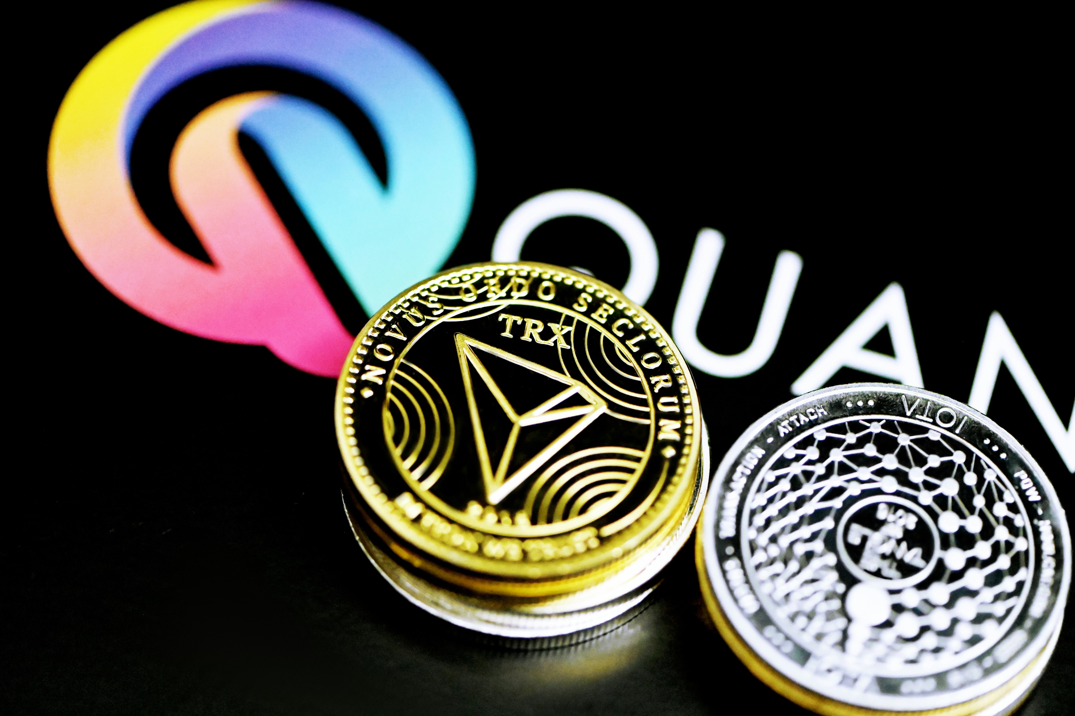
FUNCTIONAL REQUIREMENTS
NON-FUNCTIONAL REQUIREMENTS
User Registration
Real-Time Market Data & News
Financial Analysis & Research Tools
Portfolio Management
Performance Requirements
Usability Requirements
Easy To Use

Slide 7



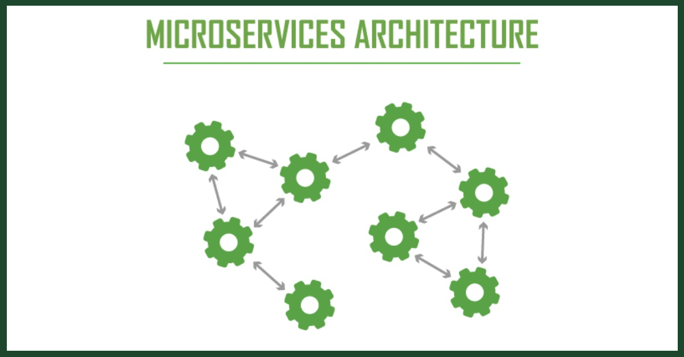



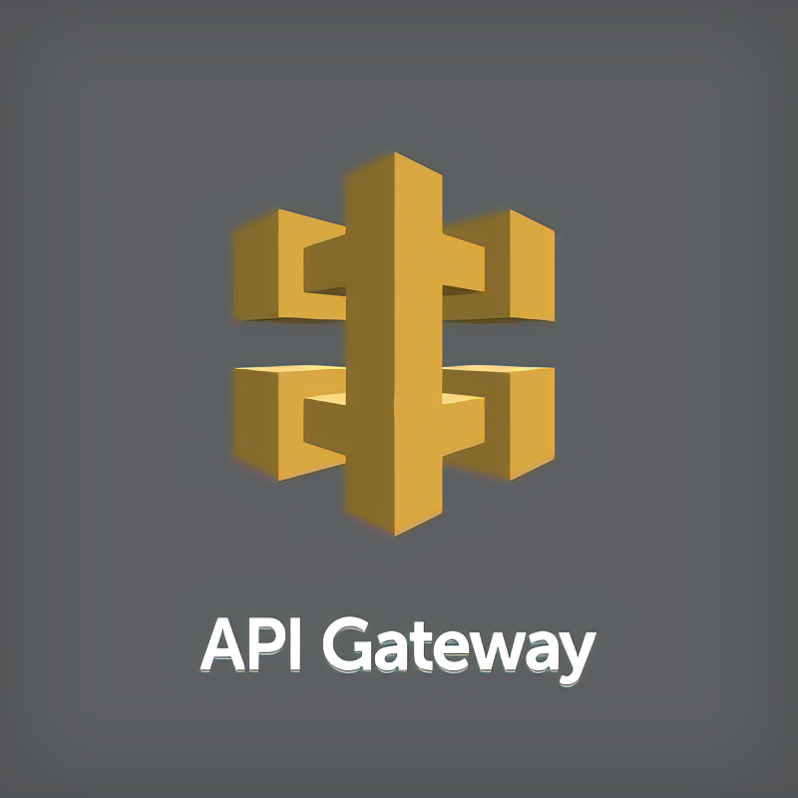
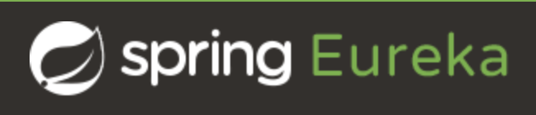

TECHNOLOGIES AND TOOLS USED

Slide 8


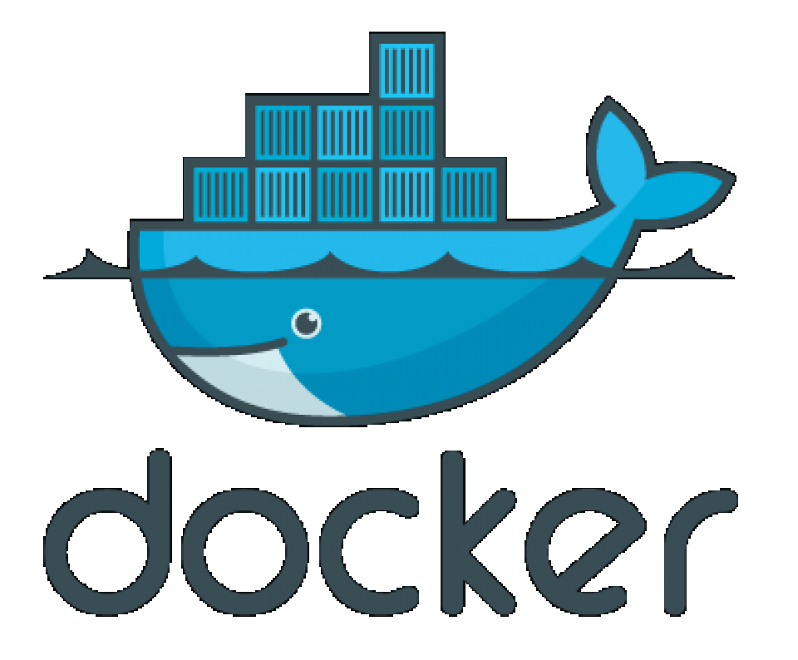

CLOUD SERVICES

Slide 9
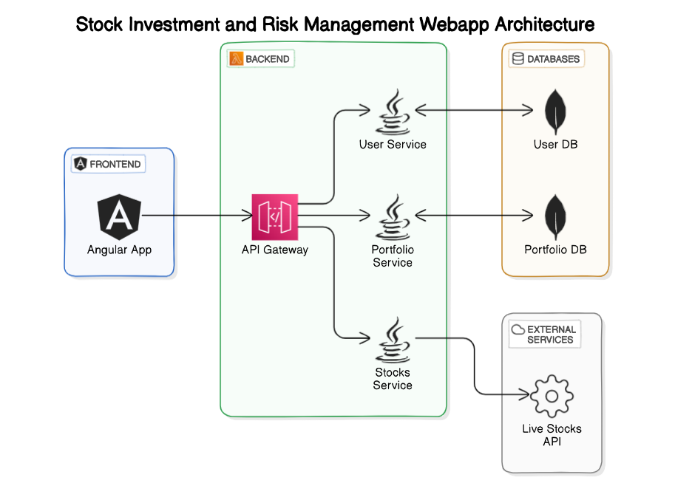
APPLICATION ARCHITECHTURE

Slide 10
APPLICATION FEATURES
Investor Can
Login / Sign Up
Add/Delete/Modify Portfolio
Buy/Sell Available Crypto
Keep an Eye on Crypto Details

Slide 11
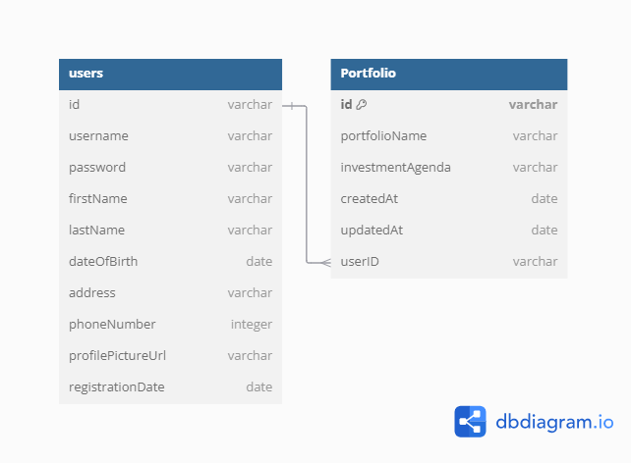
DATABASE DESIGN

Slide 12
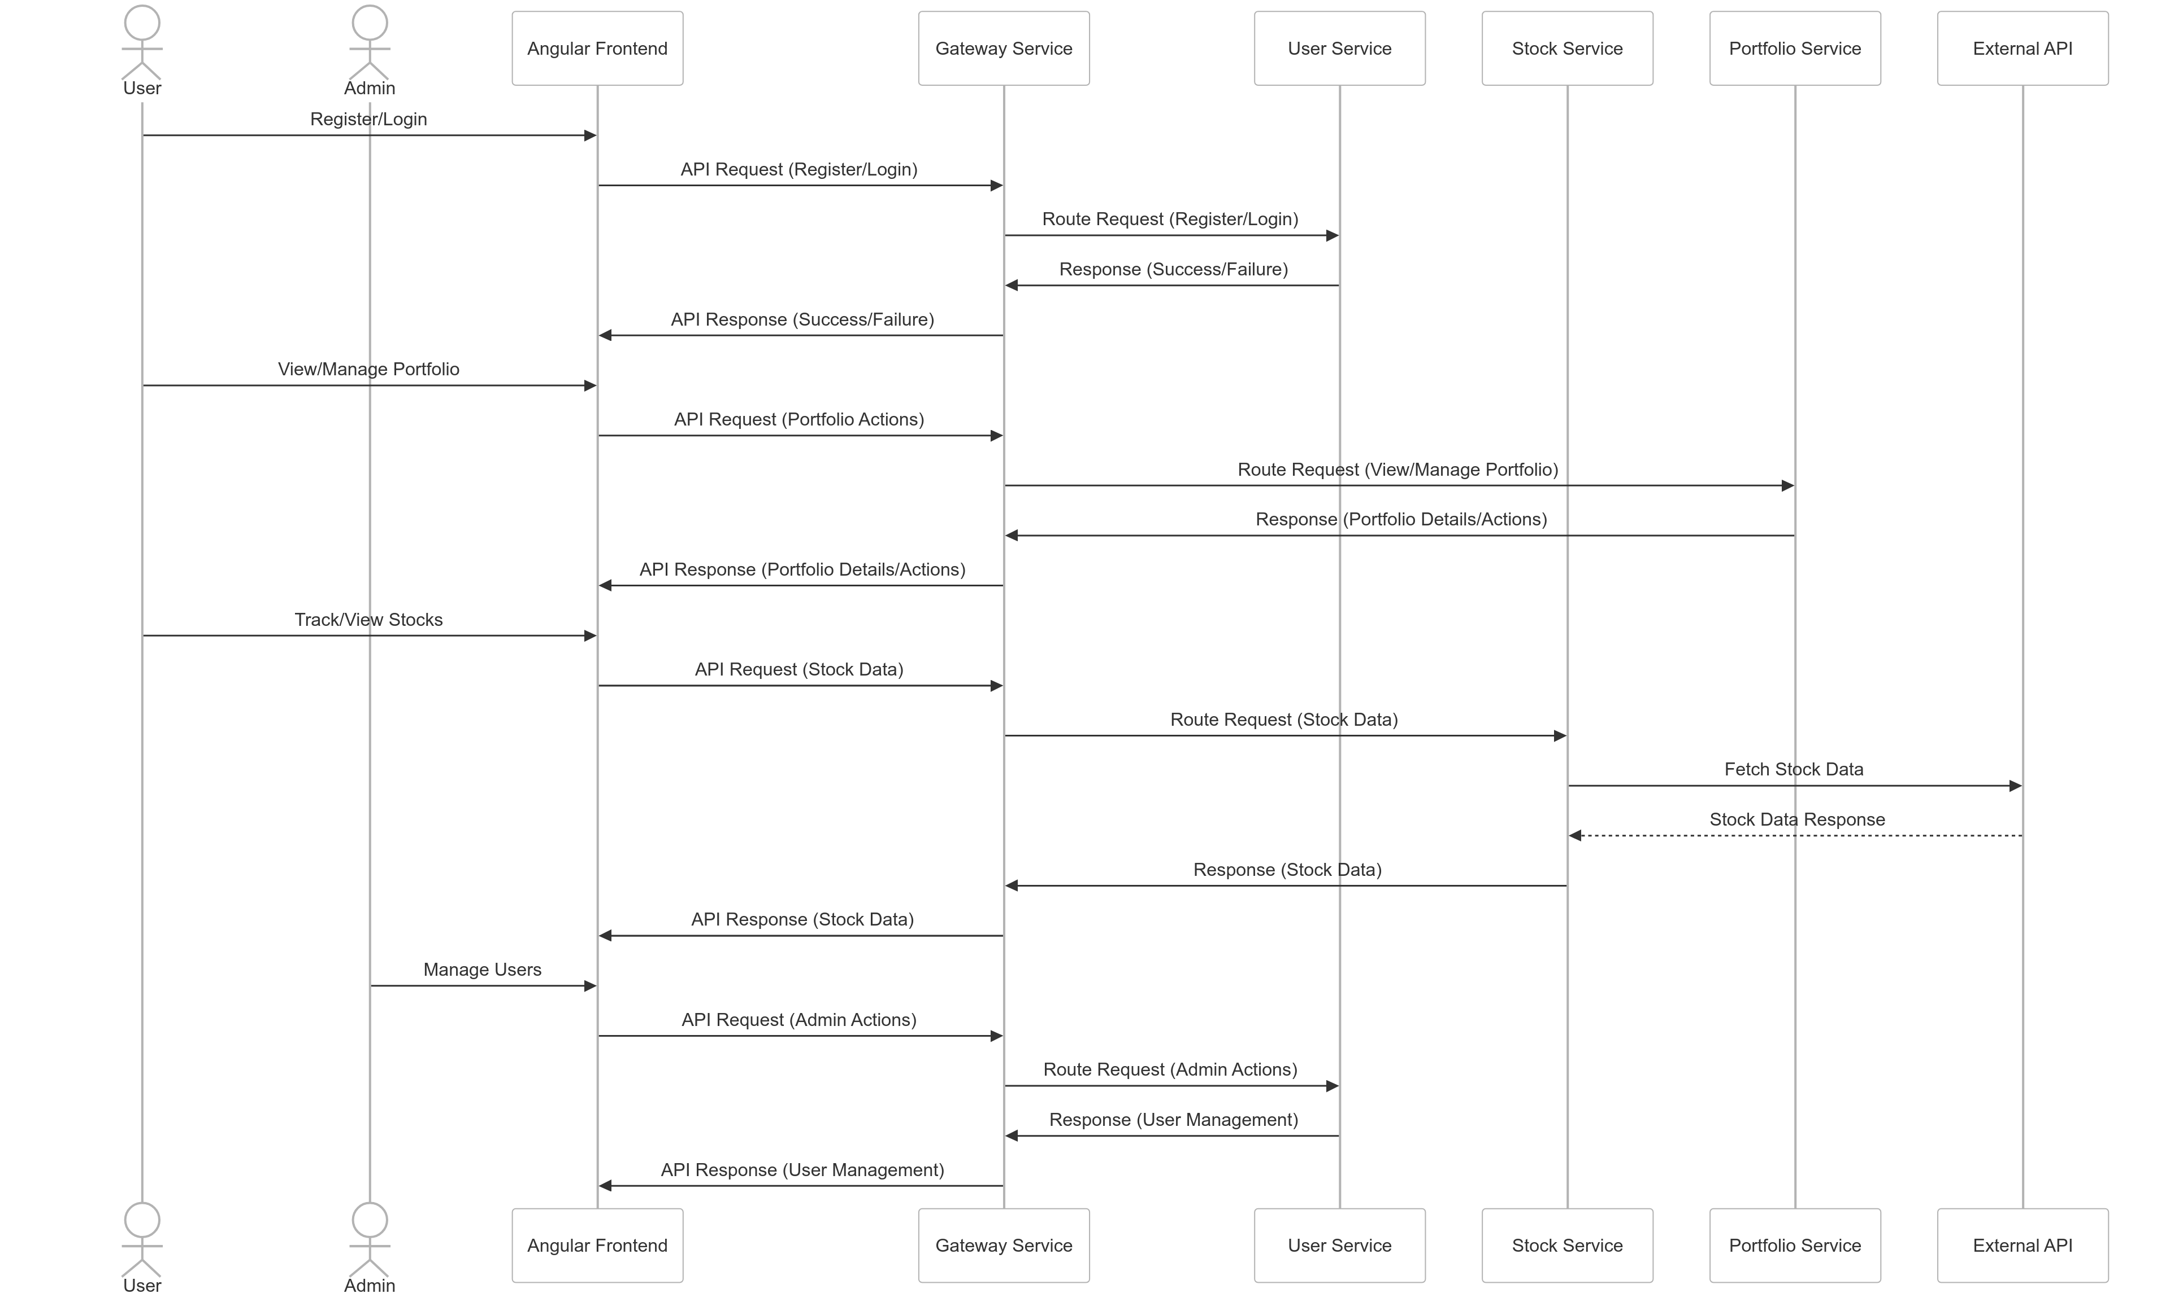
PROJECT FLOW

Slide 13

Thank you,
For providing this opportunity to develop this application and allowing us to present it.

